Slide 1
Disk Scheduling
The operating system is responsible for using hardware efficiently — for the disk drives, this means having a fast access time and disk bandwidth
Access time has two major components
Seek time is the time for the disk are to move the heads to the cylinder containing the desired sector
Rotational latency is the additional time waiting for the disk to rotate the desired sector to the disk head
Minimize seek time
Seek time ≈ seek distance
Disk bandwidth is the total number of bytes transferred, divided by the total time between the first request for service and the completion of the last transfer

Slide 2
Disk Scheduling (Cont)
Several algorithms exist to schedule the servicing of disk I/O requests
We illustrate them with a request queue (0-199)
98, 183, 37, 122, 14, 124, 65, 67
Head pointer 53
2

Slide 3
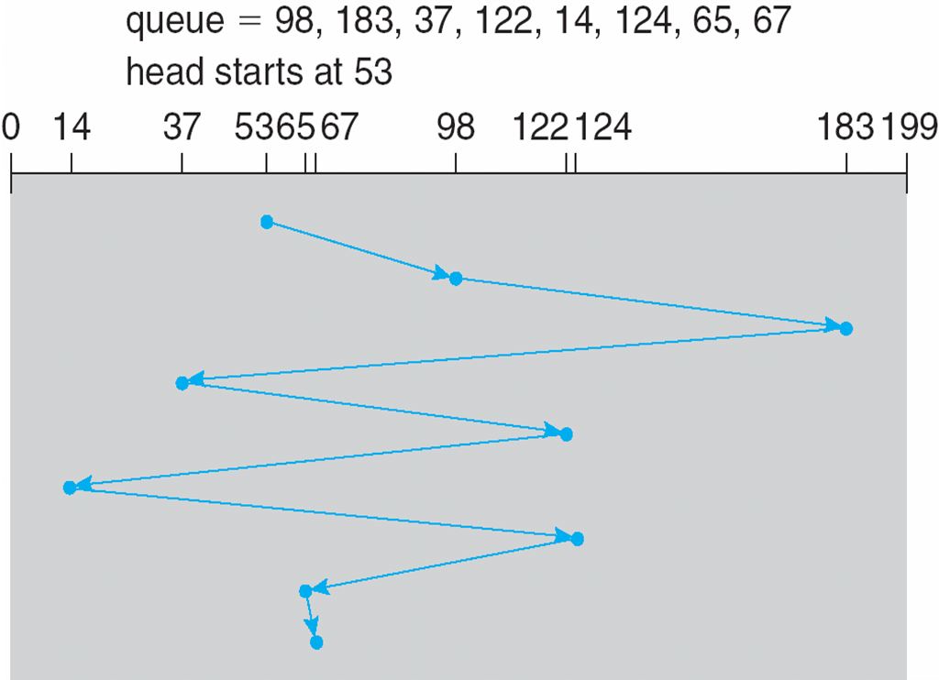
FCFS
Illustration shows total head movement of 640 cylinders
3

Slide 4
SSTF(Shortest Seek Time First)
Selects the request with the minimum seek time from the current head position
SSTF scheduling is a form of SJF scheduling; may cause starvation of some requests
Illustration shows total head movement of 236 cylinders
4

Slide 5
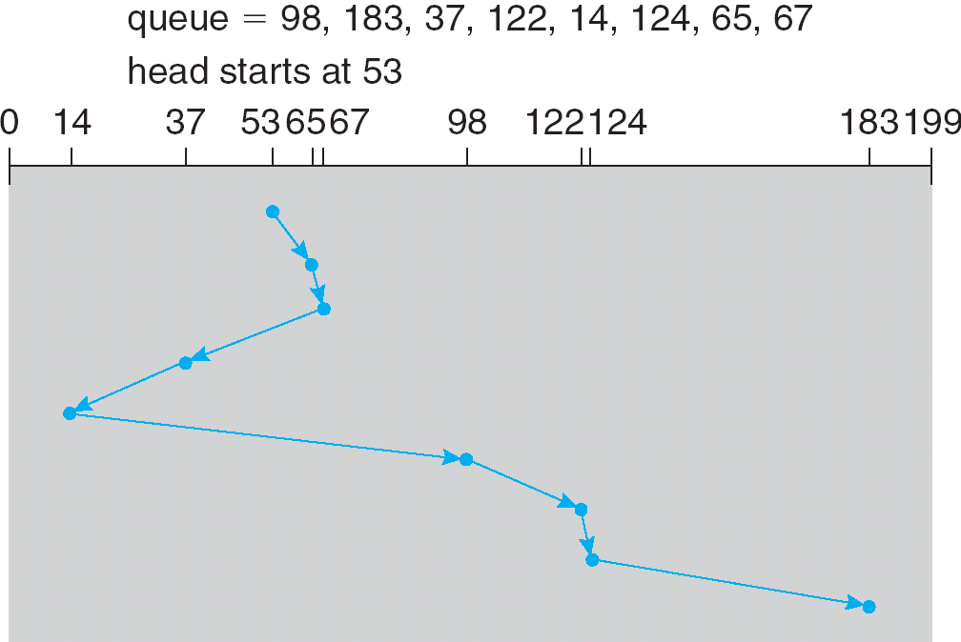
SSTF (Cont)
5

Slide 6
SCAN
The disk arm starts at one end of the disk, and moves toward the other end, servicing requests until it gets to the other end of the disk, where the head movement is reversed and servicing continues.
SCAN algorithm Sometimes called the elevator algorithm
Illustration shows total head movement of 208 cylinders
6

Slide 7
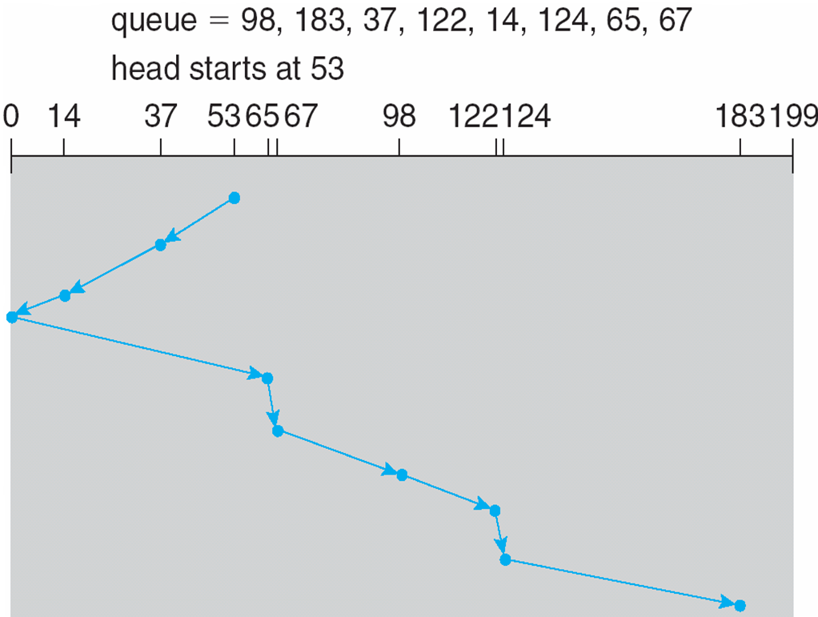
SCAN (Cont.)
7

Slide 8
C-SCAN(Circular)
Provides a more uniform wait time than SCAN
The head moves from one end of the disk to the other, servicing requests as it goes
When it reaches the other end, however, it immediately returns to the beginning of the disk, without servicing any requests on the return trip
Treats the cylinders as a circular list that wraps around from the last cylinder to the first one
8

Slide 9
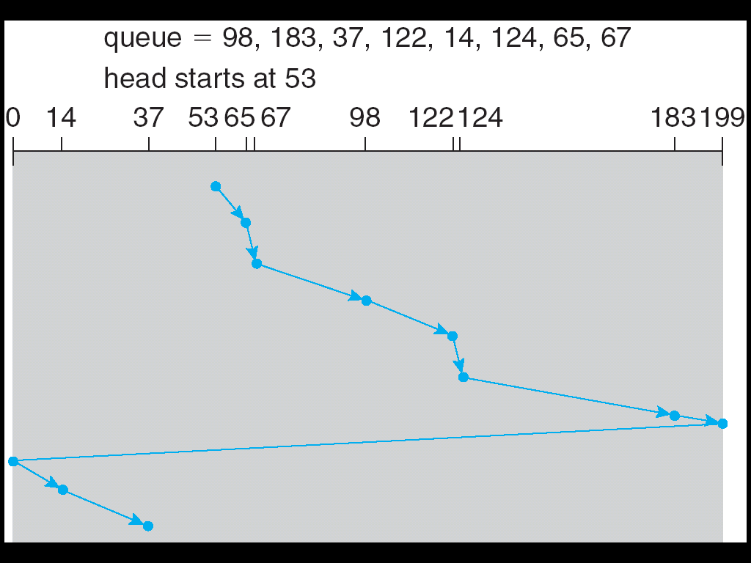
C-SCAN (Cont)
9

Slide 10
C-LOOK
Version of C-SCAN
Arm only goes as far as the last request in each direction, then reverses direction immediately, without first going all the way to the end of the disk
10

Slide 11
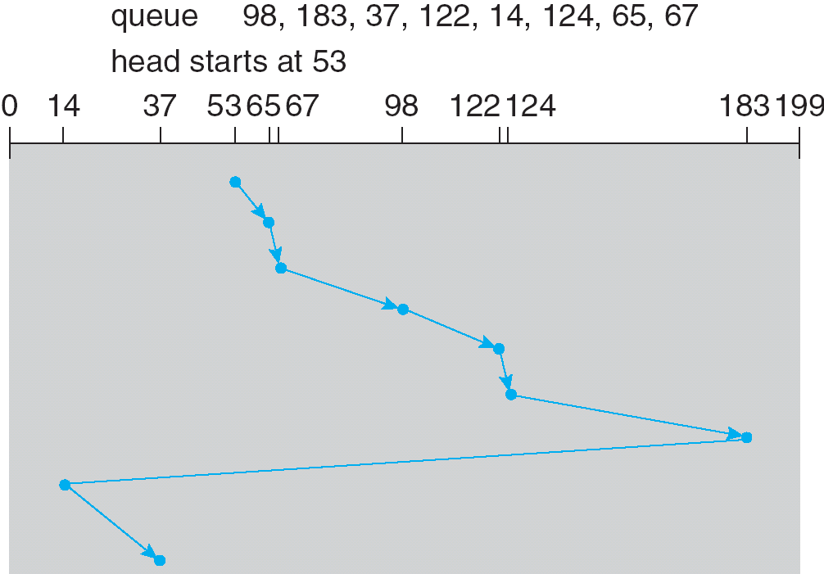
C-LOOK (Cont)
11

Slide 12
Selecting a Disk-Scheduling Algorithm
SSTF is common and has a natural appeal
SCAN and C-SCAN perform better for systems that place a heavy load on the disk
Performance depends on the number and types of requests
Requests for disk service can be influenced by the file-allocation method
The disk-scheduling algorithm should be written as a separate module of the operating system, allowing it to be replaced with a different algorithm if necessary
Either SSTF or LOOK is a reasonable choice for the default algorithm
12

